Slide 1
GRA-UML
Global Standards Council
Status update - April 2014
Cory Casanave

Slide 2
What is GRA-UML?
GRA is an Object Management Group (OMG) standards process, supported by the GSC, for enabling a model driven approach to creating and evolving GRA service specifications
GRA-UML is to be based on the Unified Modeling Language (UML) as the modeling infrastructure and language. UML is also an OMG standard
GRA-UML leverages and will reuse the existing NIEM-UML standard as the data representation. It is expected that GRA-UML will be similar in approach to NIEM-UML
The OMG RFP has been issued and is in progress
The submission team and process for GRA-UML is underway and making good progress

Slide 3
The Team
Core specification authoring team
IJIS Institute
Ashwini Jarral, Daniel Potter, Scott Serich
Model Driven Solutions (Division of Data Access Technologies)
Cory Casanave, Tom Digre, Steve Cook
Open Networks, Inc.
Bob Slaski, Todd Seymour, Girish Murthy
Extended Team
Jim Douglas (Search, GSC Representative)
Iveta Topalova-Dimitrova (Microsoft)
Vijay Mehra (ISE)
Arne Berre (Sintef – OMG SoaML)
GSC – you are invited!
OMG, Other (It is an open process)

Slide 4


GRA-UML SSP Development Process
GRA-UML
Provisioning
Implementation
Service Architect
Stakeholders
Single source of the truth
UML Tool
GRA-UML Model
NIEM-UML Model
GRA-UML Provisioning Implementation
GRA Conformant SSP
reverse

Slide 5
Fundamental questions to be defined
How are GRA service represented in UML?
What is the scope and content of the SSPs to produce?
How is one mapped to the other?

Slide 6
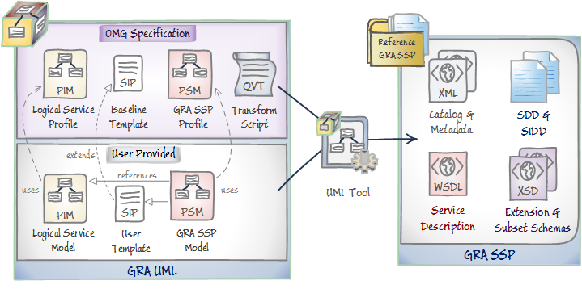
GRA-UML Components

Slide 7
Services in UML
At a high level, services in UML are typically defined using
Interfaces to show what data flows between participants
Participants (Components) with “ports” to show what services are provided and/or used by each participant
Interactions to show the choreography of interactions
Service policies (not yet standardized)
Class diagrams to define the messages (NIEM-UML in our case)
Services are frequently combined with
Activity diagrams to show the business processes of both
The collaborating community (community process)
The internal process of participants (typically separate from the service)
Capabilities behind the services
Collaborations and use cases to show how the services work together with multiple participants to meet business needs
At an implementation level, UML object models and behaviors for implementation and integration (typically separate from the service)

Slide 8
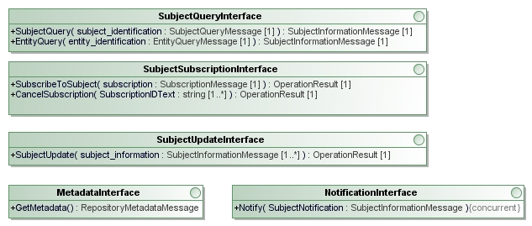
Example/notional interfaces

Slide 9
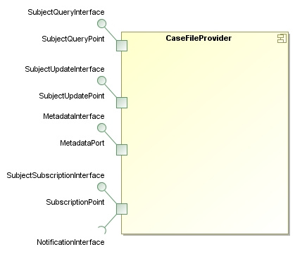
Example/notional participant with ports for services

Slide 10
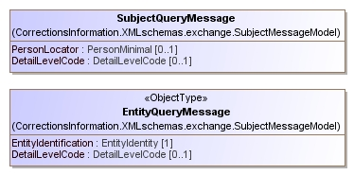
Example Messages
From NIEM-UML
References full IEPD model
NIEM IEPD

Slide 11
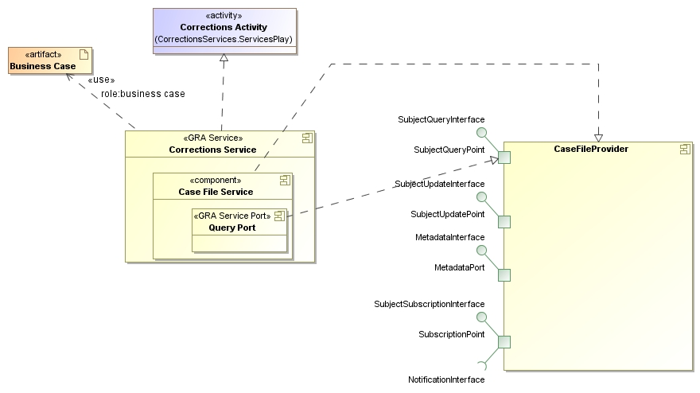
Example/notional binding to GRA
GRA Metadata contained in these “stereotypes”

Slide 12
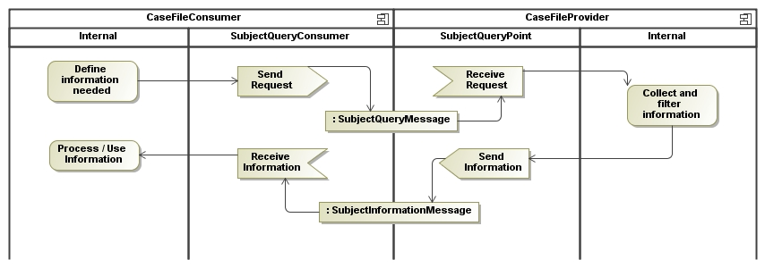
Example/notional process
Processes can contain as much detail as needed for exchange, but should not over-specify the internal “how”.

Slide 13
Separation of concerns
Separation of concerns is a key design principle
GRA-UML will separate concerns at multiple levels
Services are fully independent of internal processes, technologies or systems to use or provide services.
The logical services and processes that are needed to address business needs for service providers and users to collaborate
The GRA SSP specification adds context, metadata and selects technology choices for interfaces
The specification for how the services will be implemented with specific standards and technology choices
The completed GRA artifacts that combine the business and technology perspectives
Automation is used to help transition to the artifacts

Slide 14
Issues and resolutions

Slide 15
“Open scope” issue
GRA specifies standards to use, but the content of an SSP and the standards used is very open
Where there are specific standards, the way in which they are used can be variable
Modeling “everything you could possibly do” at the technology level and in SSP documents is therefor open ended and could be heavyweight
The exemplar SSPs provided help guide this scope, but possible choices are still very open. Exemplar SSPs will be used to validate completeness.
Our approach to this is “templates”

Slide 16
Templates
The model will focus on the services at a technology independent level
The SSP metadata will specify one or more “templates” to use
A template will define the technology package & artifacts to use, it will be parameterized by information from the model
The template & artifacts will then be “filled in” (parameterized) to produce the final SSP
The specification will define one baseline template that will produce a full SSP for secure web services
Users will be able to modify the baseline or provide their own template for different technology or documentation choices/styles
The implementation choice for template parameterization is still under consideration

Slide 17
GRA-UML Components & Templates

Slide 18
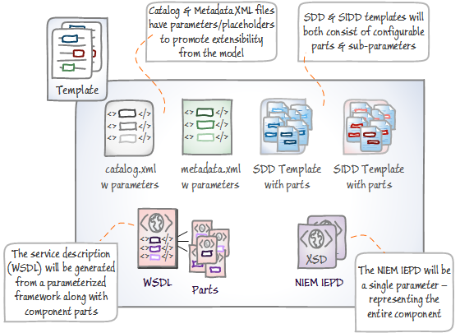
Templates define the parts of the SSP

Slide 19
Other issues & resolutions
GRA typically uses BPMN, which is not a “first class citizen” of UML. Activity diagrams (which are very similar) are typically used in UML
Resolution: The GRA-UML specification will define a binding to UML Activity diagrams. Tools may optionally utilize the “UML Profile for BPMN” to provide a compatible BPMN view
GRA documents formats: GRA specifies “.DOC or .RTF” as the format for documents. xHTML seems like a better fit for multiple reasons (Details on next page)
Resolution: We have requested that XHTML be an accepted document format in an SSP Our suggestion is to add XHTML/CSS file types to the guidelines.
Our question is: Is it acceptable for GRA-UML to use these file types instead of DOC/RTF?

Slide 20
Request to support xHTML documents
General advantages:
XHTML (the xml conformant version of HTML) is the most widely supported document format on the planet. It can be read by anything with wide technology support (even smart phones).
It is non-proprietary and current
It does not require any proprietary tools to read or create as does DOC
It allows linking between SSP documents and to or from external documents
It would allow a SSP to be directly browsed
It is sufficiently rich to provide for high quality, user focused presentation
The “.doc” format is legacy (replaced by DOCX) and RTF more limited.
Specific advantages for GRA-UML
XHTML would allow all artifacts manipulated by users or automation to be consistently in XML format
There are better tools to create XML from models and to transform or template XML
In the “template” approach we are considering it would be easier for users to work with XML/XHTML than templated DOC or RTF.

Slide 21
Request to support xHTML documents
Disadvantages
No known disadvantages
Notes
While there are browser dependencies in HTML, such dependencies should be able to be avoided for this purpose. Basic HTML/CSS should be sufficient.
The resulting documents would not, in general, be “one file”, however this does not seem to be a disadvantage. Auxiliary resources (e.g. images) would be in a subdirectory as is usual for HTML. Such a directory could be one catalog entry.
Note that alternatives are “.ODT” (open doc format used by open office) and .DOCX (Microsoft’s open doc flavor).

Slide 22
Next Steps
Scope & approach document within 2 weeks
Internal draft document: June 2014
Initial submission to OMG: Sept 2014
Final submission to OMG: Dec 2014

Slide 23
Questions and Discussion

